Slide 1



TFM Vladyslav Dodonov
View in Power BI
Last data refresh:
16/10/2025 21:17:23 UTC
Downloaded at:
16/10/2025 21:19:11 UTC

Slide 2
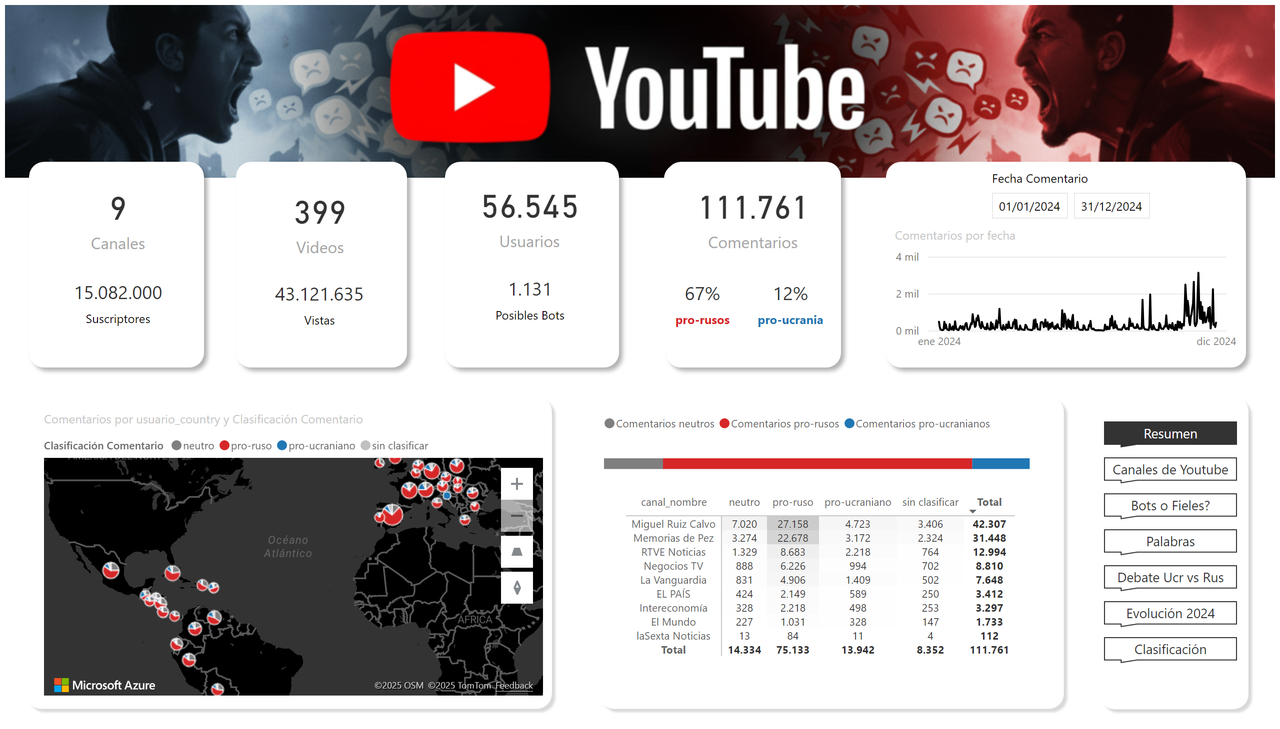
Resumen
Notes:
image
No alt text provided
barChart
No alt text provided
pivotTable
No alt text provided
shape
No alt text provided
card
No alt text provided
card
No alt text provided
shape
No alt text provided
card
No alt text provided
card
No alt text provided
card
No alt text provided
shape
No alt text provided
lineChart
No alt text provided
slicer
No alt text provided
shape
No alt text provided
card
No alt text provided
card
No alt text provided
shape
No alt text provided
card
No alt text provided
card
No alt text provided
shape
No alt text provided
azureMap
No alt text provided
shape
No alt text provided
shape
No alt text provided
pageNavigator
No alt text provided

Slide 3
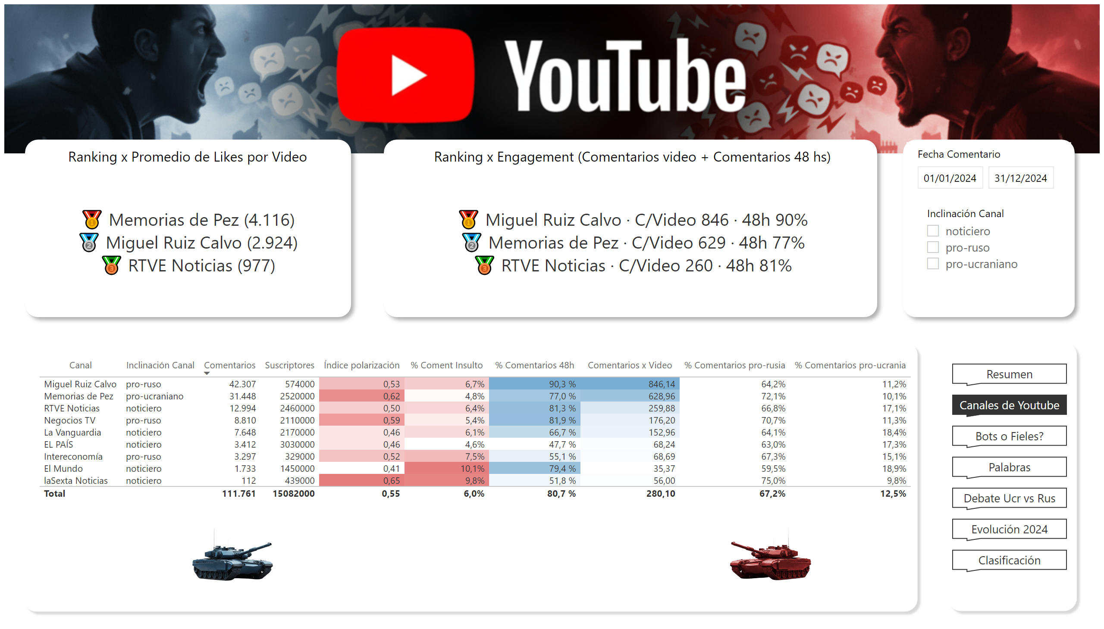
Canales de Youtube
Notes:
image
No alt text provided
tableEx
No alt text provided
shape
No alt text provided
image
No alt text provided
shape
No alt text provided
slicer
No alt text provided
shape
No alt text provided
shape
No alt text provided
shape
No alt text provided
pageNavigator
No alt text provided
Ranking x Promedio de Likes por Video
No alt text provided
slicer
No alt text provided
Ranking x Engagement (Comentarios video + Comentarios 48 hs)
No alt text provided
image
No alt text provided

Slide 4
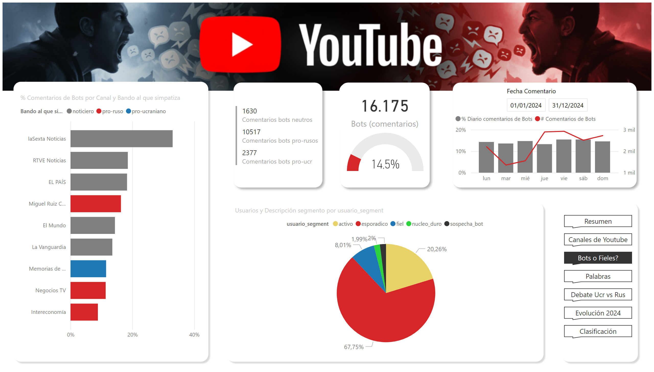
Bots o Fieles?
Notes:
image
No alt text provided
shape
No alt text provided
shape
No alt text provided
shape
No alt text provided
pageNavigator
No alt text provided
barChart
No alt text provided
lineStackedColumnComboChart
No alt text provided
slicer
No alt text provided
shape
No alt text provided
card
No alt text provided
shape
No alt text provided
gauge
No alt text provided
pieChart
No alt text provided
multiRowCard
No alt text provided
shape
No alt text provided

Slide 5
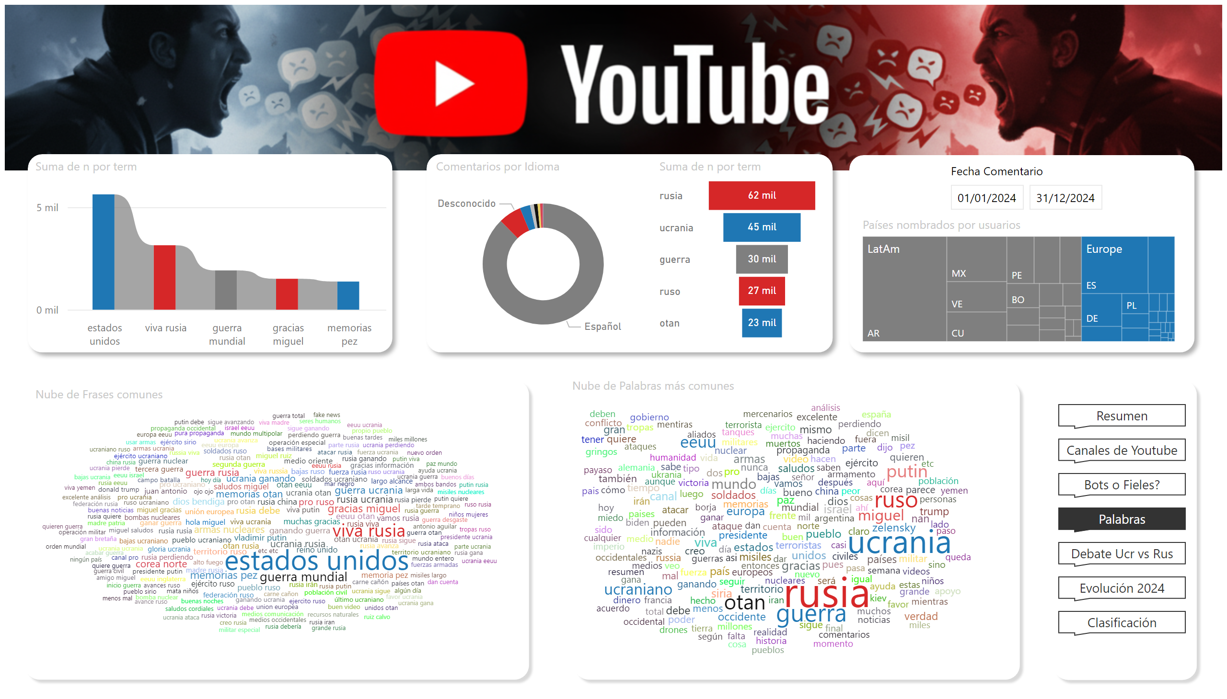
Palabras
Notes:
image
No alt text provided
shape
No alt text provided
shape
No alt text provided
slicer
No alt text provided
Países nombrados por usuarios
No alt text provided
shape
No alt text provided
shape
No alt text provided
shape
No alt text provided
shape
No alt text provided
pageNavigator
No alt text provided
Nube de Frases comunes
No alt text provided
Nube de Palabras más comunes
No alt text provided
funnel
No alt text provided
ribbonChart
No alt text provided
Comentarios por Idioma
No alt text provided

Slide 6
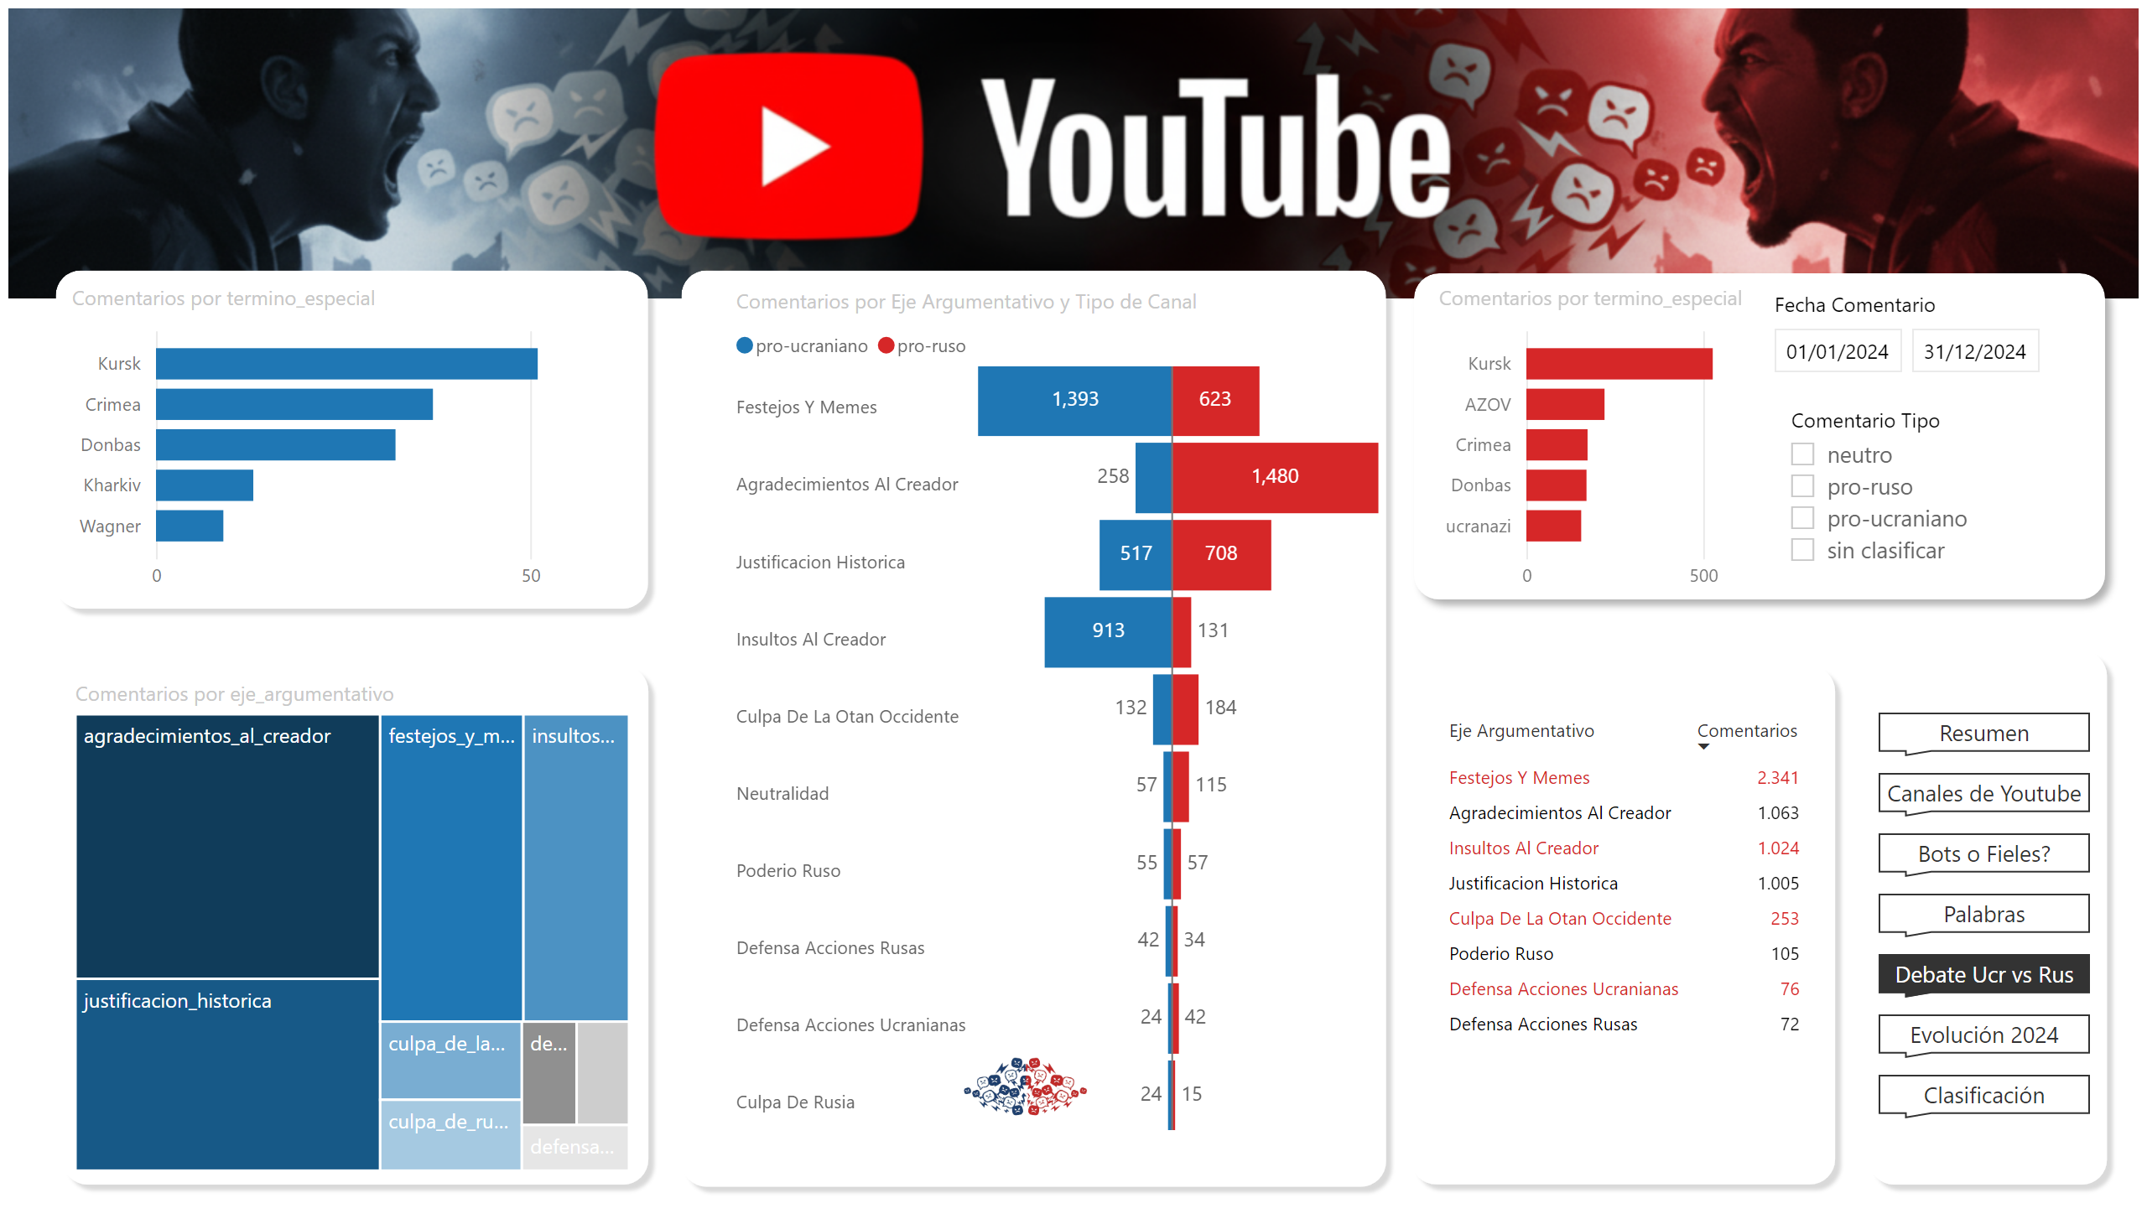
Debate Ucr vs Rus
Notes:
image
No alt text provided
shape
No alt text provided
shape
No alt text provided
pageNavigator
No alt text provided
shape
No alt text provided
Comentarios por Eje Argumentativo y Tipo de Canal
No alt text provided
clusteredBarChart
No alt text provided
treemap
No alt text provided
shape
No alt text provided
image
No alt text provided
tableEx
No alt text provided
shape
No alt text provided
slicer
No alt text provided
clusteredBarChart
No alt text provided
shape
No alt text provided
slicer
No alt text provided

Slide 7
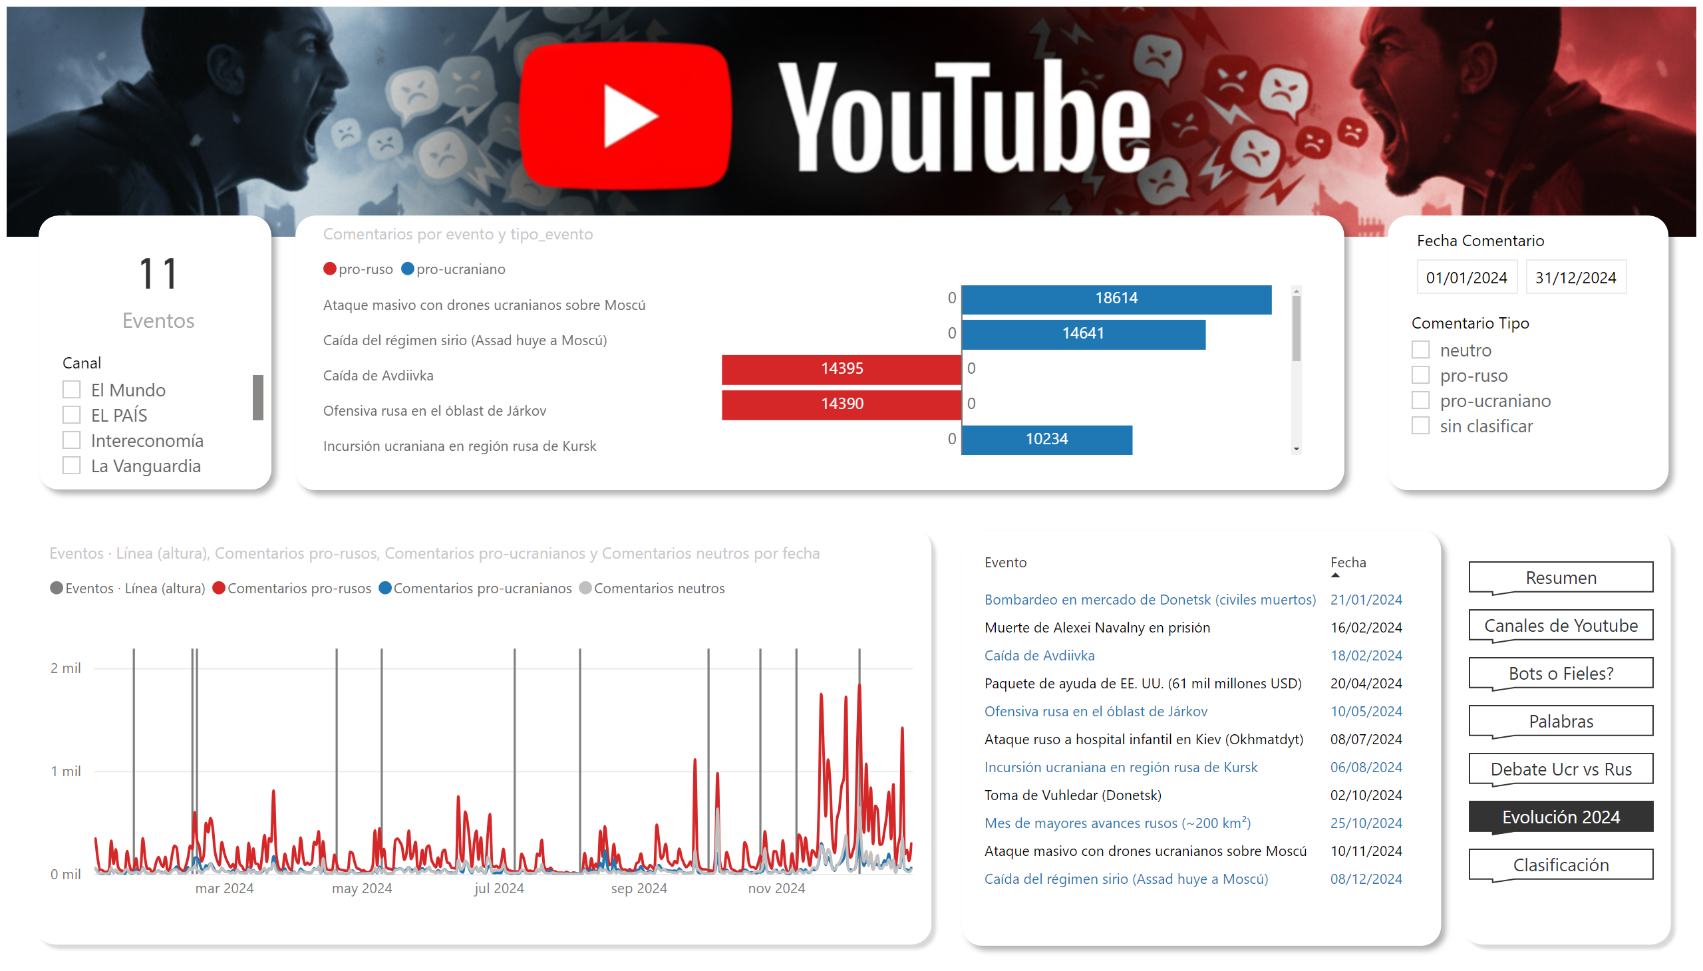
Evolución 2024
Notes:
image
No alt text provided
TornadoChart1452517688218
No alt text provided
shape
No alt text provided
slicer
No alt text provided
shape
No alt text provided
slicer
No alt text provided
slicer
No alt text provided
card
No alt text provided
shape
No alt text provided
shape
No alt text provided
pageNavigator
No alt text provided
lineClusteredColumnComboChart
No alt text provided
shape
No alt text provided
tableEx
No alt text provided
shape
No alt text provided

Slide 8
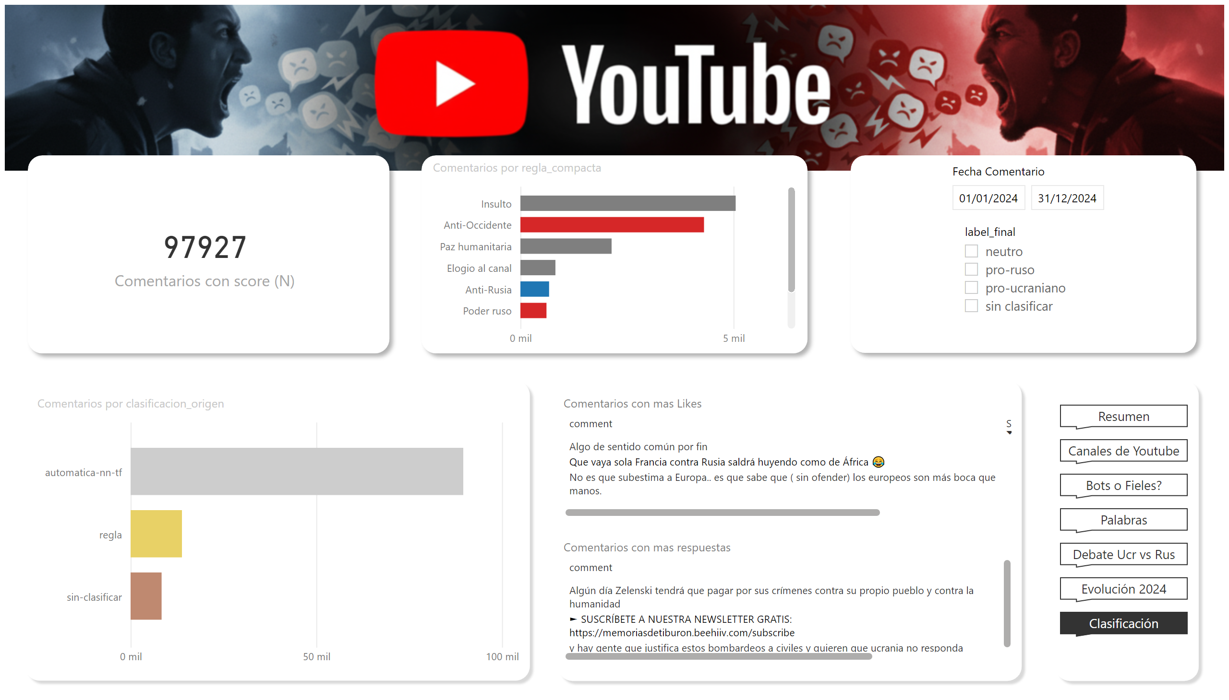
Clasificación
Notes:
image
No alt text provided
shape
No alt text provided
shape
No alt text provided
slicer
No alt text provided
slicer
No alt text provided
shape
No alt text provided
shape
No alt text provided
shape
No alt text provided
barChart
No alt text provided
shape
No alt text provided
pageNavigator
No alt text provided
Comentarios con mas Likes
No alt text provided
Comentarios con mas respuestas
No alt text provided
clusteredBarChart
No alt text provided
card
No alt text provided

